Slide 1
Web Design Project --Abbott Hotel
Presented by Development Group :
Chang, liu
Qianfeng, sun
Hong Bo, Li
Li, Qian

Slide 2
End goal and target audience
END GOAL
PRIMARY: Cater to the most exclusive clientele
SECONDARY: Show information about the hotel and book rooms
TARGET AUDIENCE
- high-end travelers: individual, couples and families
- business travelers for work purpose
- Guest attending events or celebrations

Slide 3
Sitemap
Header: Location | Language | Currency
Logo | About us | Dining | Spa |Rooms | Events | Book Now | Search
Footer: Newsletter Subscription |Reviews |FAQ | Contact us
Copyright

Slide 4
FUTURE CONSIDERATIONS:
- Video outline showing our exclusive service
- Careers
- VIP Club

Slide 5
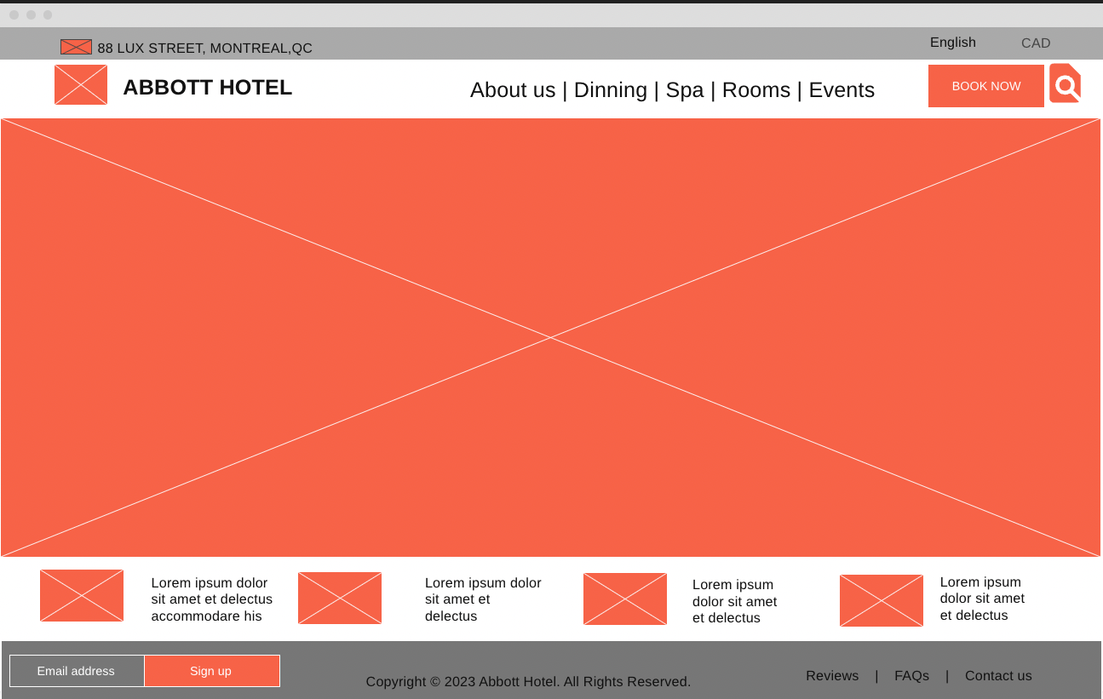
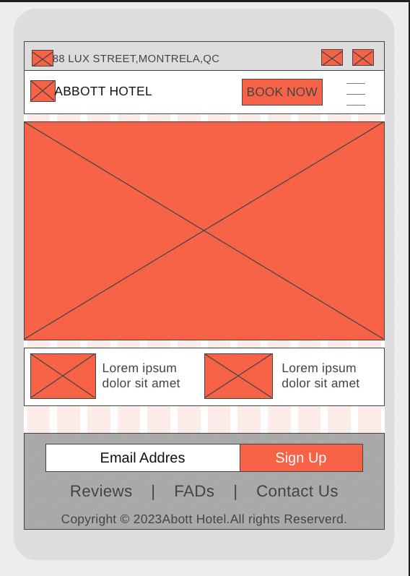
Wireframes of desktop and mobile

Slide 6
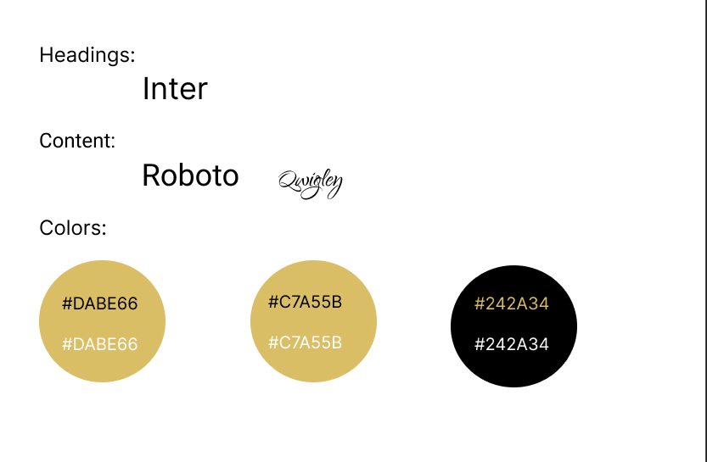
Visual fonts and color selection

Slide 7
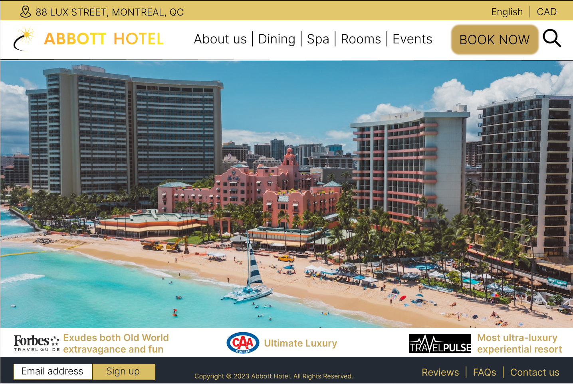
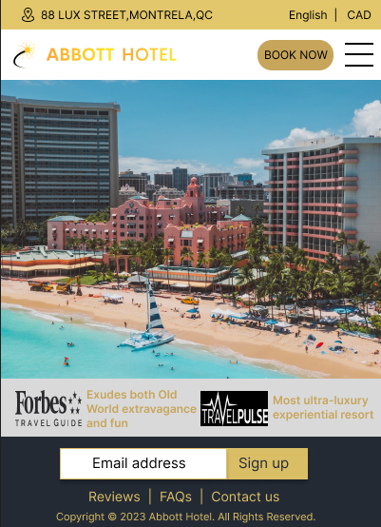
Mock-ups of desktop and mobile

Slide 8
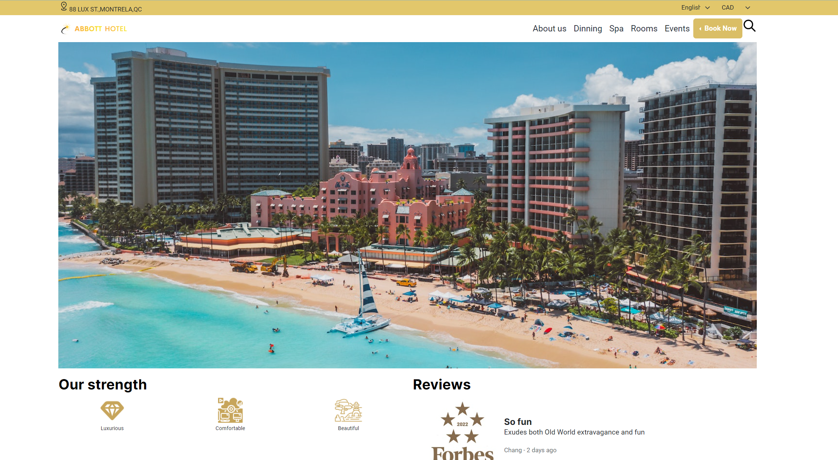
Homepage

Slide 9
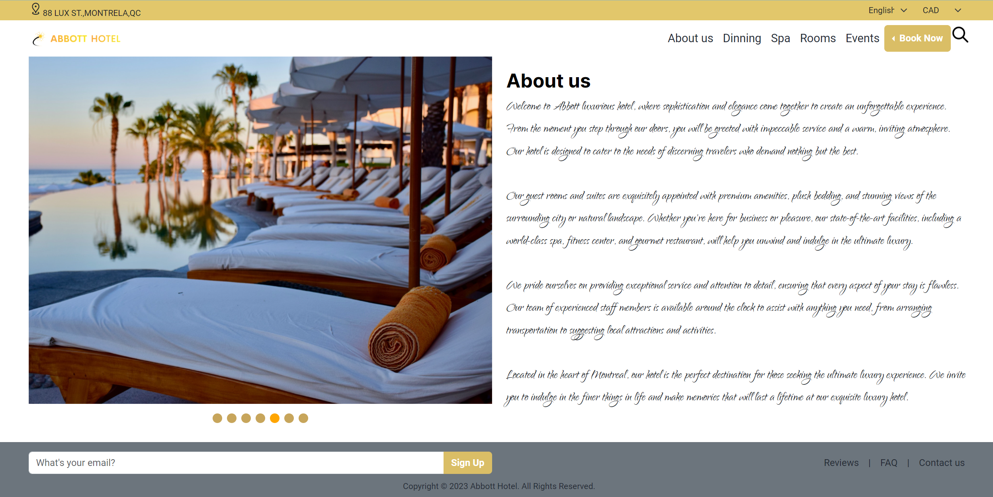
About us

Slide 10
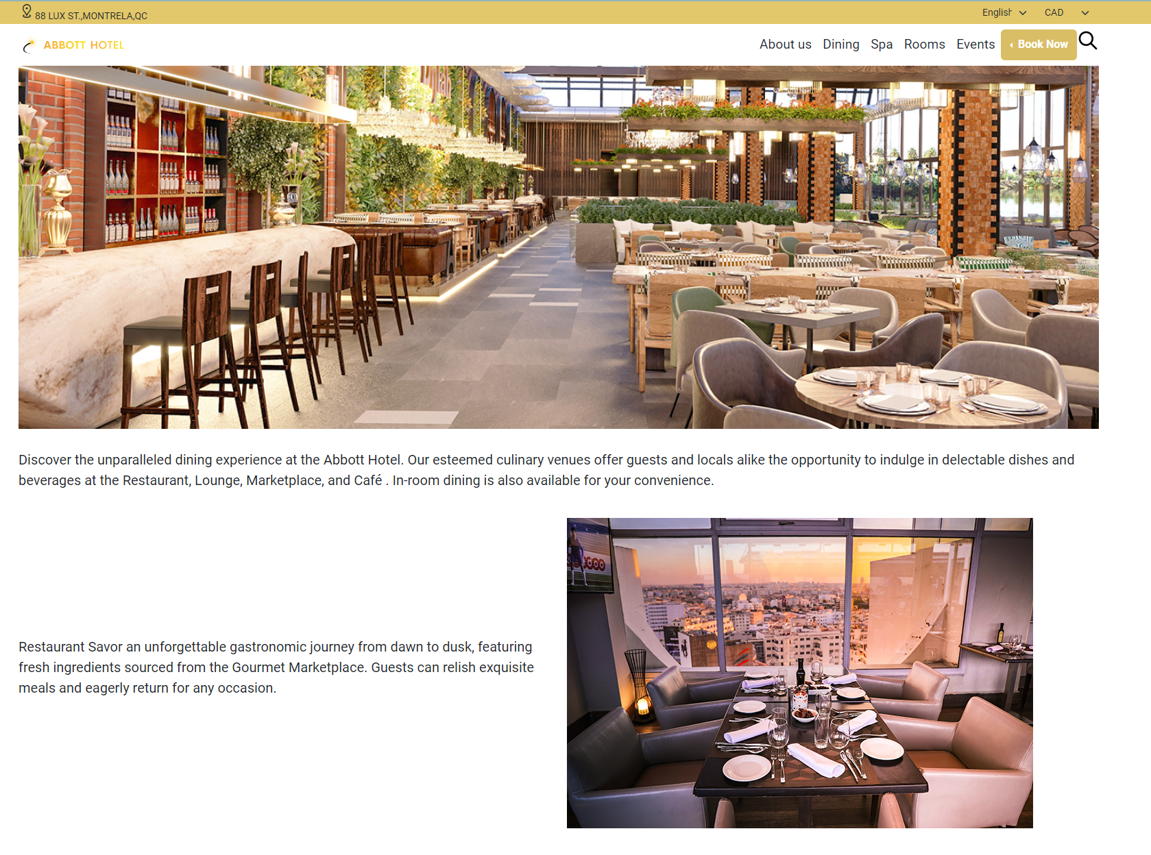
Dinning

Slide 11
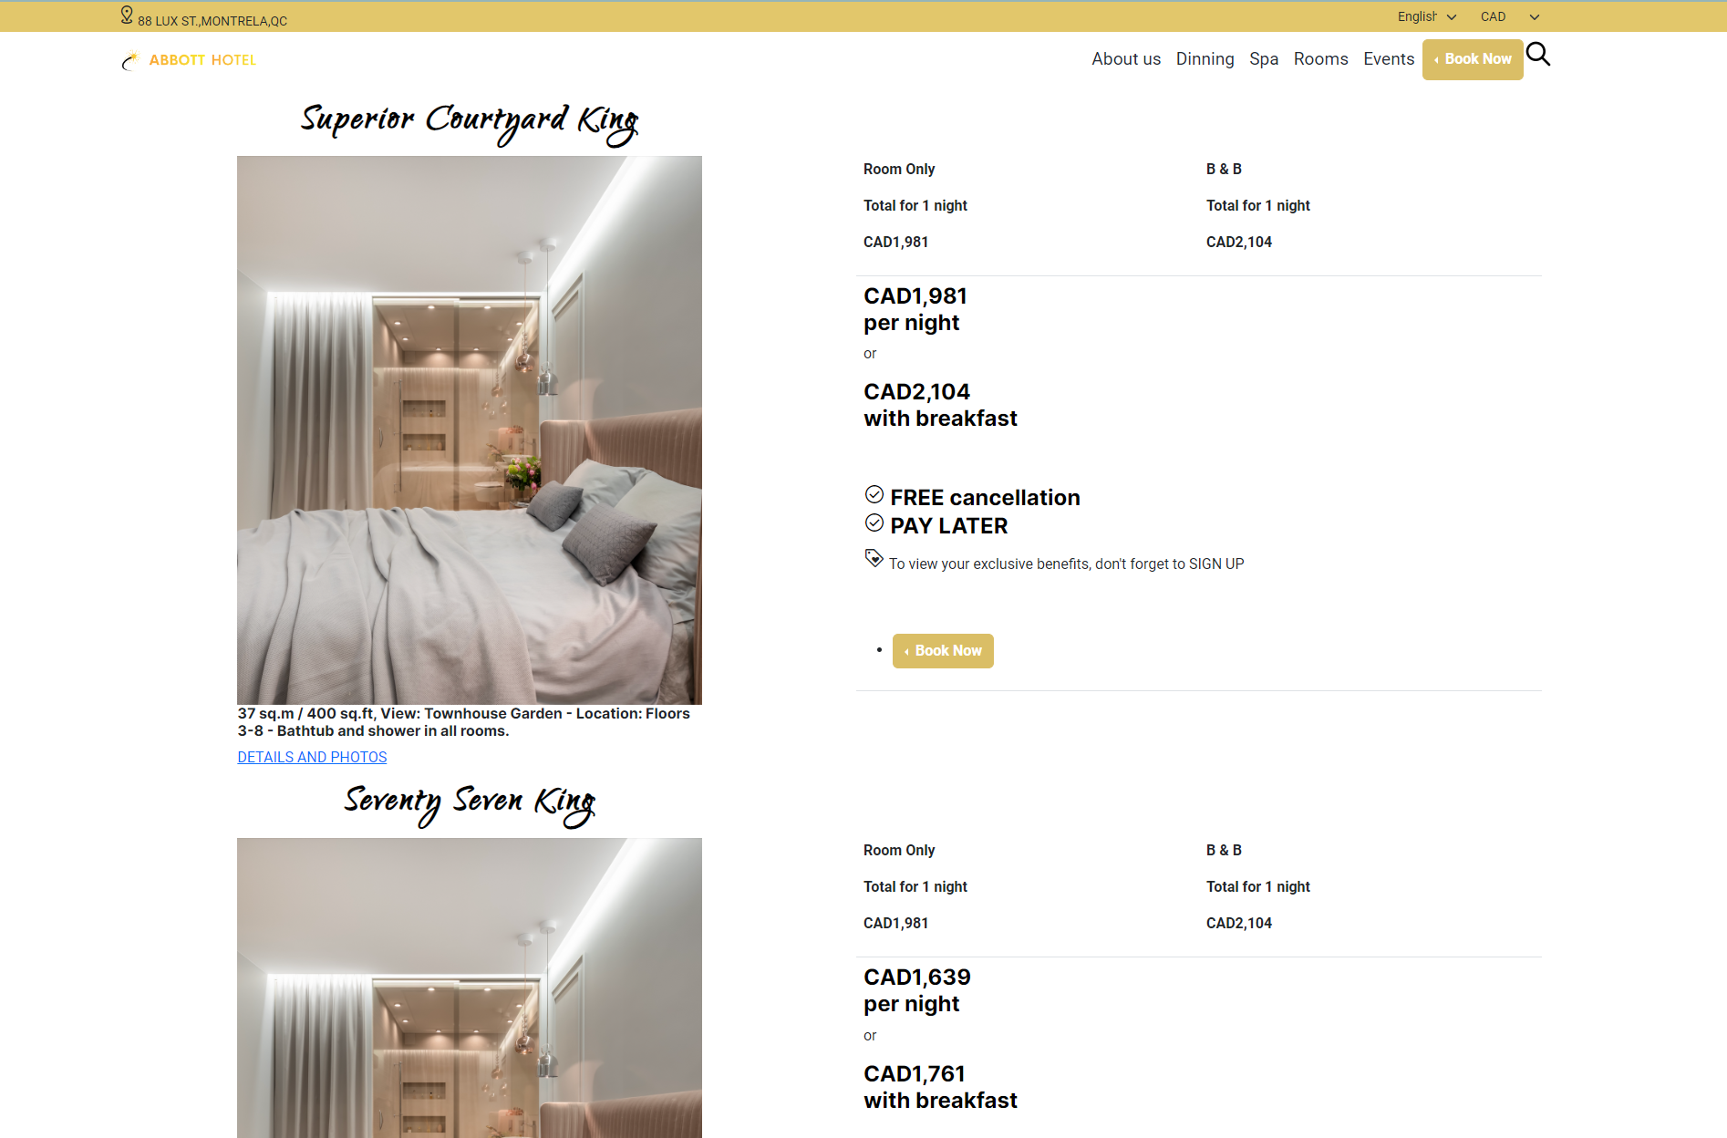
Rooms

Slide 12



Thank you for our time

